Slide 1
MULTI-THREADING

Slide 2
What is Multithreading?
Running or Executing multiple threads simultaneously is called Multithreading.
Threads are lightweight as compare to process hence execution of a thread is very efficient and fast.
Eg → any single line which is currently executed by the CPU is a thread.

Slide 3
Advantages of Multithreading
Doesn't block the user : Threads are independent and you can perform multiple operations at same time.
Perform many operations together so it saves time.
Independent: Threads are independent so it doesn't affect other threads if exception occur in a single thread.

Slide 4
Thread Life Cycle
A thread can be in one of the five states.
The life cycle of the thread in java is controlled by JVM. The java thread states are as follows:
New
Runnable
Running
Non-Runnable (Blocked)
Terminated

Slide 5
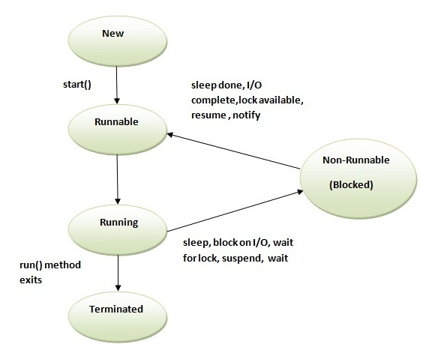
Thread Life Cycle

